Slide 1
Rockbuster Stealth: Data Analysis
Sebrea Wilmore, Data Analyst

Slide 2

OVerview
Rockbuster Stealth LLC is a movie rental company that used to have stores around the world. Facing stiff competition from streaming services such as Netflix and Amazon Prime, the Rockbuster Stealth management team is planning to use its existing movie licenses to launch an online video rental service in order to stay competitive.
The Rockbuster Stealth Management Board has asked a series of business questions in order to begin crafting their decisions as it pertains to the 2020 company strategy.

Slide 3

OBJECTIVES
● Determine which movies contributed the most and least to revenue gain
● Identify the countries that Rockbuster customers based in
● Identify the locations for customers with a high lifetime value
● Determine whether sales figures vary between geographic regions

Slide 4
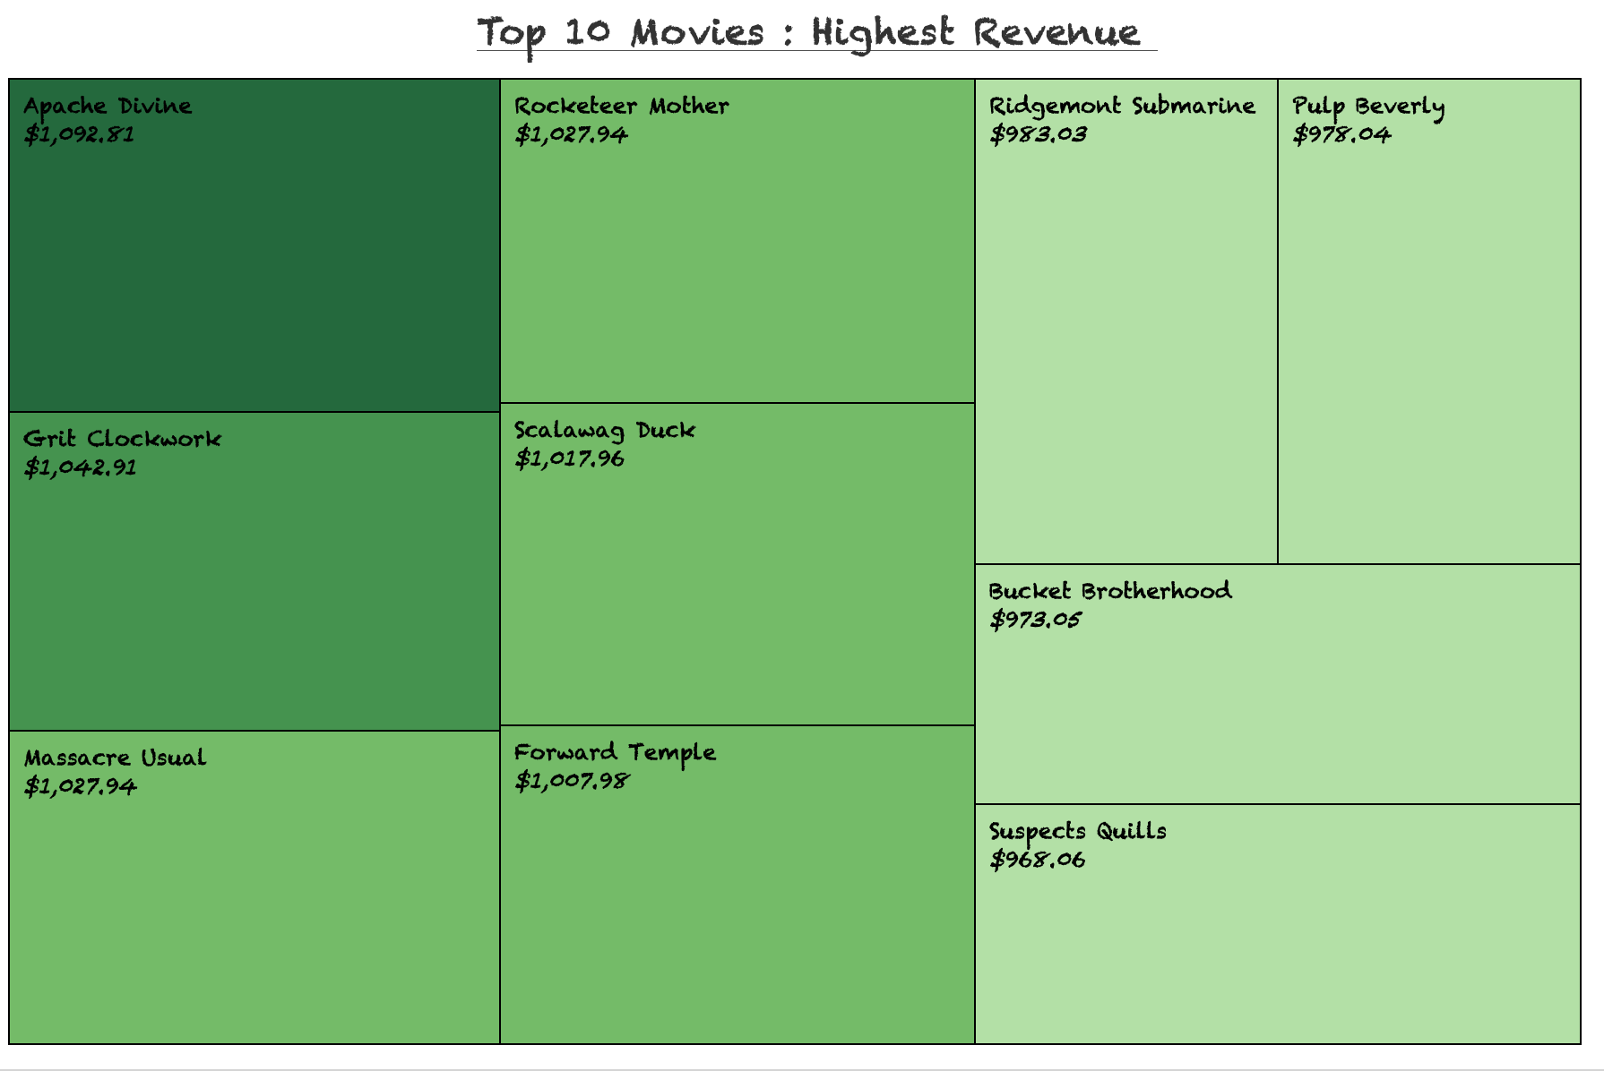
Movies with high revenue contribution
Apache Divine had the largest contribution, grossing $1,092.81

Slide 5
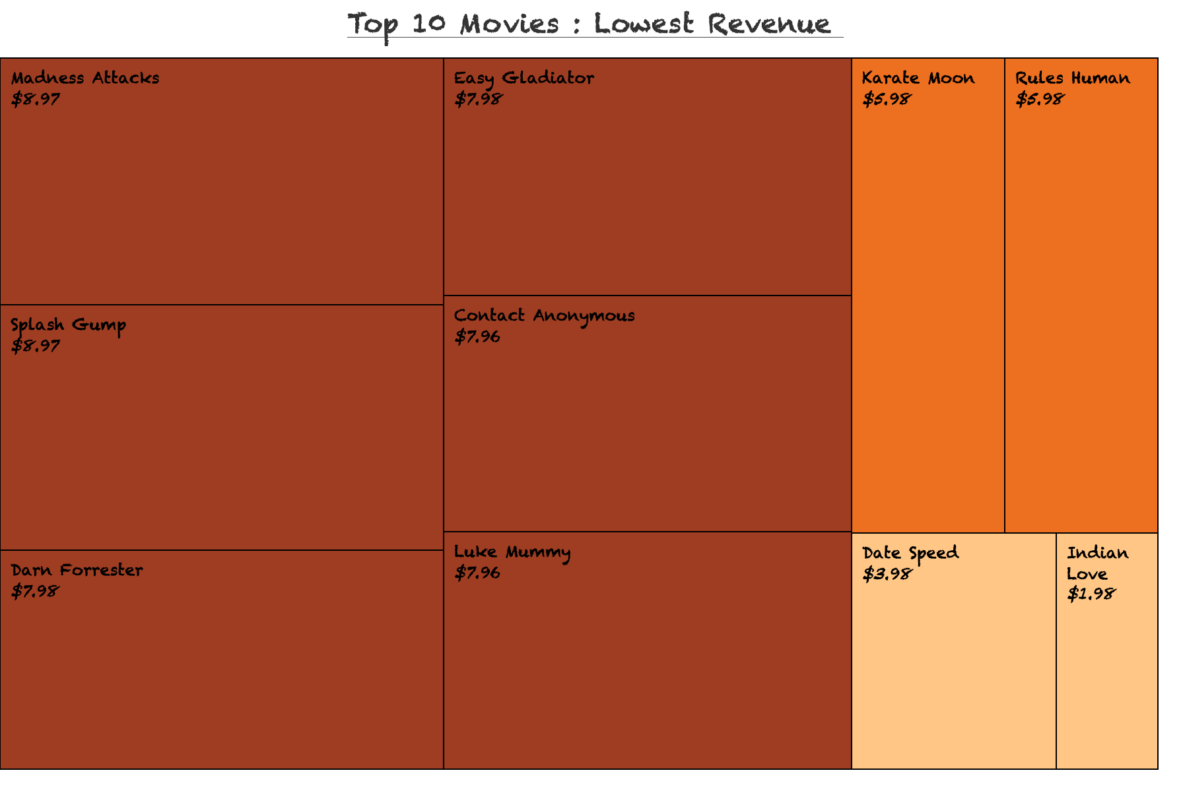

Movies with low revenue contribution
Indian Love had the lowest contribution, grossing $1.98

Slide 6
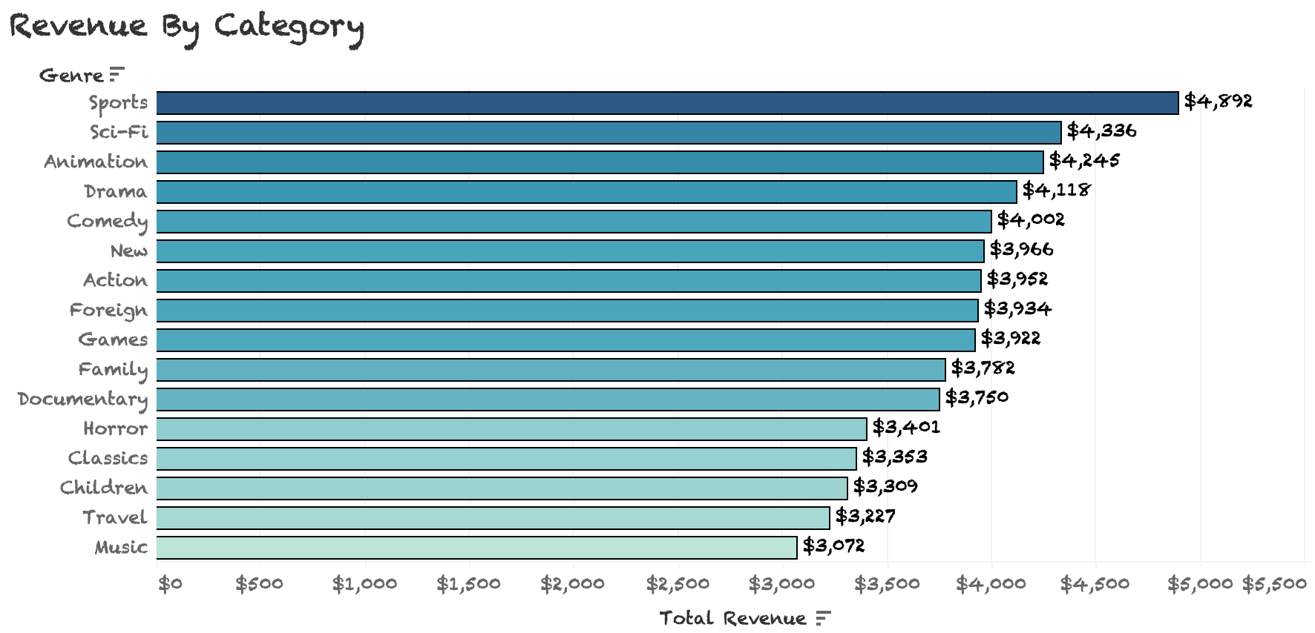
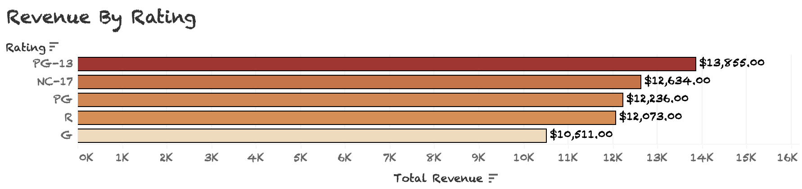
Revenue by genre and rating
PG-13, NC-17, and PG movies make up 63% of the company revenue
This bar chart illustrates the total revenue for each category. Sports ranked the highest with a total of $4,892. Music is the lowest genre with a total of $3,072

Slide 7
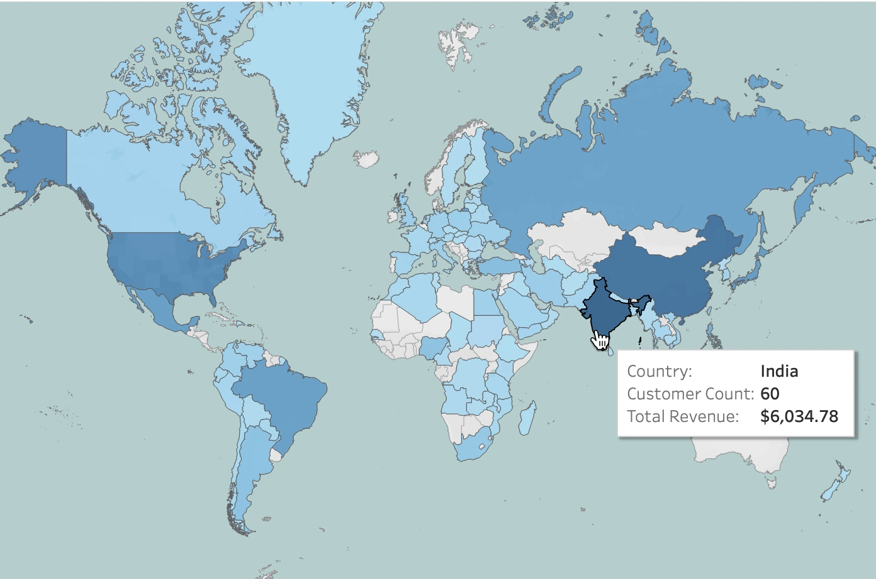
rockbuster’s most profitable countries
The top 3 countries with the highest revenue AND customer count are India, China, and Japan
To view video, hover over image then press play
To view full map click here

Slide 8
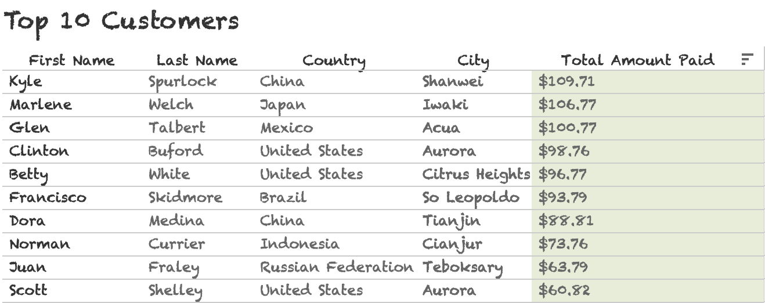
Customers with a high lifetime value : Where are they located?
Customers with a high lifetime value are found throughout different regions of the world.
The most customers are located in China and the United States

Slide 9
Recommendations
To increase competition in the online market, a moderate portion of the marketing budget should go towards promoting the top 10 highest grossing movies with increased funding allocated to lower performing countries that have a total revenue lower than $500.
New and existing customers should gain access to a free 3 month premium subscription. As it gets closer to their renewal date , a satisfaction survey should be sent incentivizing a discounted premium annual subscription upon completion . The survey should contain open ended questions pertaining to the customers experience navigating the platform, movie selection, and cost of the subscription.
To increase revenue, funds should go towards acquiring the licenses for popular Sports, Sci-Fi, and Animation movies that performed well in their respective countries box office, as well as cult classics to attract new customers from different regions.

Slide 10
Questions?
Contact me at:
sebreaw@gmail.com

